Slide 1

Default of Credit Card Client
Group #1 Members:
Jimmy Kim, Ernawaty Ernawaty, Mounika Lingala, Judy Pin, Thet Win

Slide 2
What is Credit Card Default?
DEFINITION
A credit card default occurs when a cardholder fails to pay their debt for an extended period, typically 180 days. Credit card delinquency and net loss rates impact a financial institution in multiple areas which may result in reorganization within departments of the bank.
WHAT HAPPENS IF YOU DEFAULT ON A CREDIT CARD?
Delinquency on your credit report.
Debt in collections.
Closed credit account
HOW TO AVOID DEFAULTING ON CREDIT CARDS?
Pay more than the minimum balance due.
Build emergency fund for unexpected expenses.
Keep an eye on expenses and bank statements.
Prioritize paying off higher interest debts.
Consider debt consolidation.
Source: https://www.businessinsider.com/

Slide 3
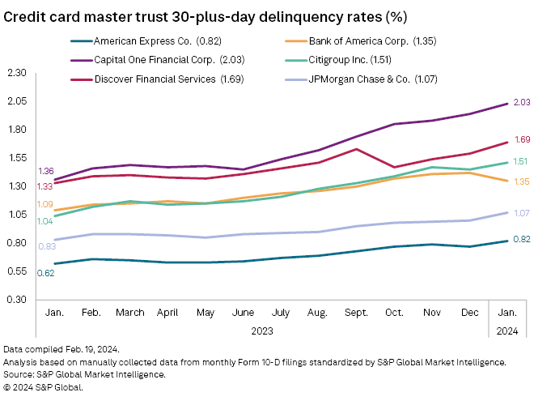
Delinquency Rates of Six U.S. Credit Card Issuers
The January 2024 average delinquency rate for the six card issuers was up from 1.36% in December 2023, and from 1.05% a year ago.
Source: https://www.spglobal.com/

Slide 4
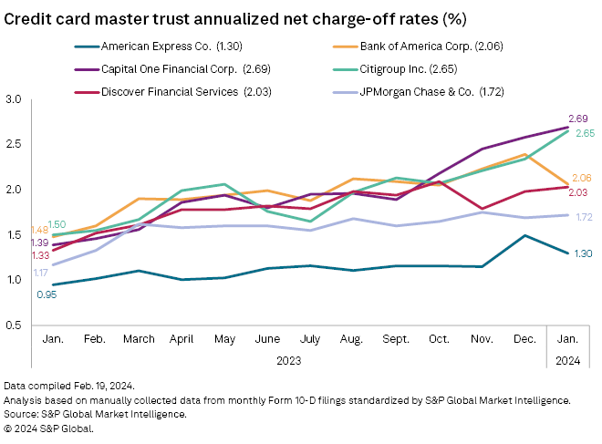
Charge-Off Rates of Six U.S. Global Credit Card Issuers
The average annualized net loss rate for the six major US credit cards was somewhat flat sequentially, at 2.07% in January — edging lower from 2.08% at the end of 2023 — but still 77 basis points higher than a year ago.
Source: https://www.spglobal.com/

Slide 5
Business Requirements
IDENTIFY POTENTIAL DEFAULT OF CREDIT CARD CLIENTS
Are there specific demographic groups that are more likely to default?
KEY DRIVERS FOR CHARGE-OFF RATES
What are some of the Key Drivers that may impact charge off (write-offs) rates?
Are there specific demographic groups that correlate to late payments (key driver)?
CREDIT SCORE & CREDIT UTILIZATION RATIO
Which demographic groups have behavior patterns (i.e. spending and repayment patterns) that correlate positively or negatively to factors that impact their credit score calculations?

Slide 6


DATA ANALYTICS AND VISUALIZATION

Slide 7
DEFINING SOURCE DATA
DATASET INFORMATION
This dataset contains information on default payments, demographic factors, credit data, history of payment, and bill statements of credit card clients in Taiwan from April 2005 to September 2005.
ID | ID of each client
LIMIT_BAL | Amount of given credit in NT dollars (includes individual and family/supplementary credit
SEX | Gender (1=male, 2=female)
EDUCATION | (1=graduate school, 2=university, 3=high school, 4=others, 5=unknown, 6=unknown)
MARRIAGE | Marital status (1=married, 2=single, 3=others)
AGE | Age in years
PAY_0 | Repayment status in September, 2005 (-1=on time, 1=delay 1 month, 2=delay 2 months, …)
PAY_2 | Repayment status in August, 2005 (scale same as above)
PAY_3 | Repayment status in July, 2005 (scale same as above)
PAY_4 | Repayment status in June, 2005 (scale same as above)
PAY_5 | Repayment status in May, 2005 (scale same as above)
PAY_6 | Repayment status in April, 2005 (scale same as above)
BILL_AMT1 | Amount of bill statement in September, 2005 (NT dollar)
BILL_AMT2 | Amount of bill statement in August, 2005 (NT dollar)
BILL_AMT3 | Amount of bill statement in July, 2005 (NT dollar)
BILL_AMT4 | Amount of bill statement in June, 2005 (NT dollar)
BILL_AMT5 | Amount of bill statement in May, 2005 (NT dollar)
BILL_AMT6 | Amount of bill statement in April, 2005 (NT dollar)
PAY_AMT1 | Amount of previous payment in September, 2005 (NT dollar)
PAY_AMT2 | Amount of previous payment in August, 2005 (NT dollar)
PAY_AMT3 | Amount of previous payment in July, 2005 (NT dollar)
PAY_AMT4 | Amount of previous payment in June, 2005 (NT dollar)
PAY_AMT5 | Amount of previous payment in May, 2005 (NT dollar)
PAY_AMT6 | Amount of previous payment in April, 2005 (NT dollar)
default.payment.next.month | Default payment (1=yes, 0=no)
There are 25 variables
The scope of the analysis for this project is based on the following demographics:
Age group | Sex | Education | Marital Status
Correlation Heatmap
Credit Utilization Ratio
Distribution of late payments
Monthly Spend Analysis
Credit balance payment patterns

Slide 8
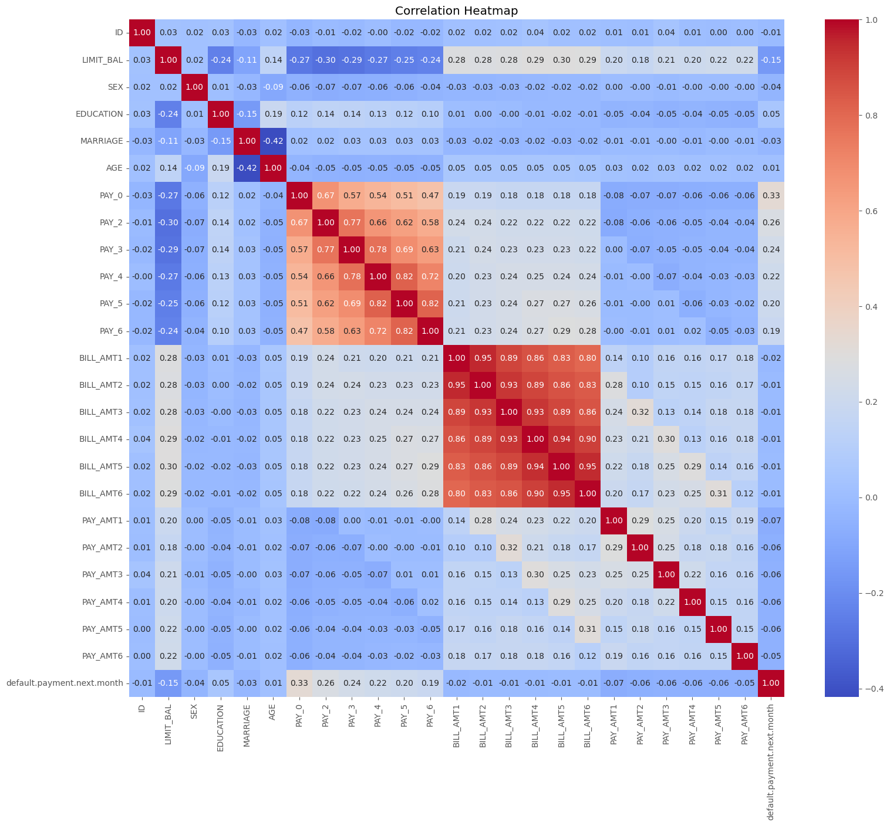
Correlation Heatmap
Default Payment Next Month
The target variable default.payment.next.month is positively correlated with the repayment status variables (PAY_0 to PAY_6), indicating that delayed payments increase the likelihood of default. It has a slight negative correlation with LIMIT_BAL, suggesting that clients with higher credit limits are somewhat less likely to default.

Slide 9
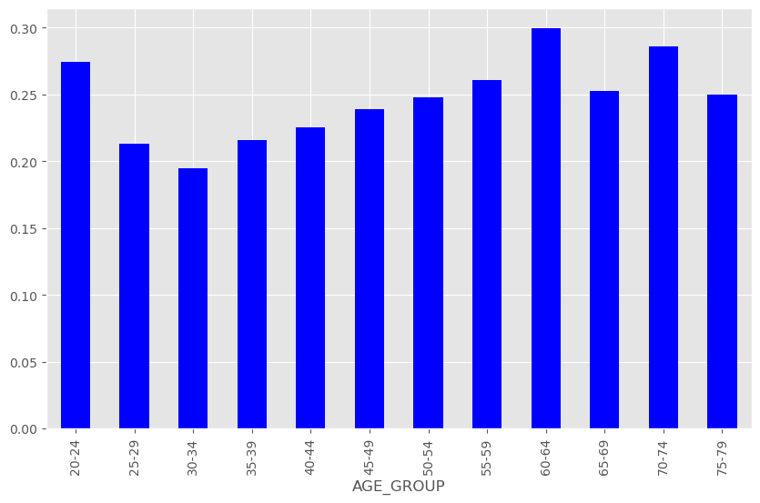
AGE BY DEFAULT RATE
Credit card clients between the ages of 30 to 34 have the lowest rate of defaulting, while the age group of 60-64 has the highest rate.

Slide 10
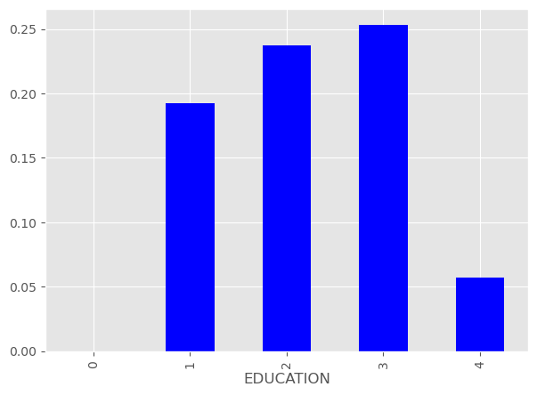
EDUCATION BY DEFAULT RATE
* EDUCATION: 0 assume less than a high school degree, 1 is graduate school, 2 is university degree, 3 is high school, 4 is others
We observed that clients with higher education than high school education are less likely to default.

Slide 11
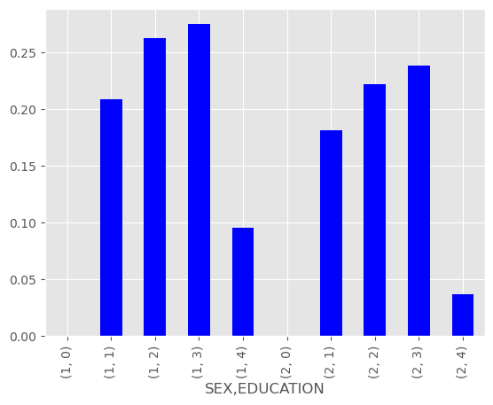
SEX AND EDUCATION BY DEFAULT RATE
Male clients with less than university degree education correlates with higher rates of default.
Sex:
1 = Male
2 = Female
Education:
0 assume less than high school education
1 = Graduate school
2 = University degree
3 = High school
4 = Other

Slide 12
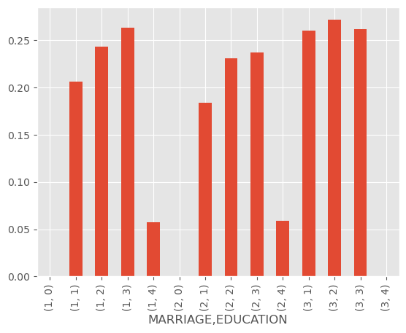
MARRIAGE AND EDUCATION BY DEFAULT RATE
Married clients with highschool education and ‘Other’ marital status clients with university degree education are more likely to default.
Marital Status:
1 = Married
2 = Single
3 = Other
Education:
0 assume less than high school education
1 = Graduate school
2 = University degree
3 = High school
4 = Other

Slide 13
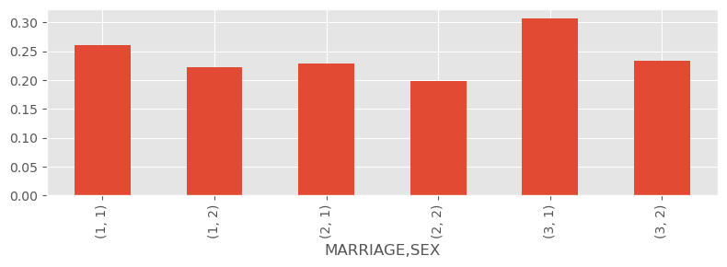
MARRIAGE AND SEX BY DEFAULT RATE
Married clients who are male are more likely to default, while single female clients are the least likely to default.
Married Men
Marital Status:
1 = Married
2 = Single
3 = Other
Sex:
1 = Male
2 = Female
Single Female

Slide 14
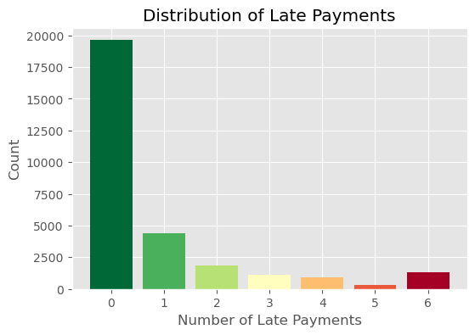
DISTRIBUTION OF LATE PAYMENTS
Our analysis indicates that majority of the credit card clients pay on-time. While the number of late payments decreases over time there is a slight increase when it comes to accounts that were 6 times late to their payment.
66%
1%

Slide 15
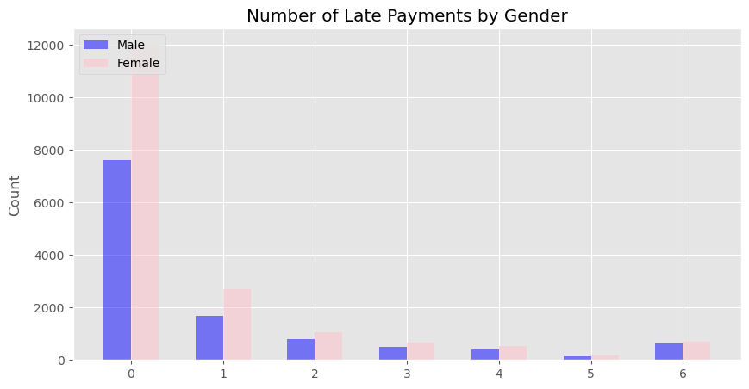
DISTRIBUTION OF LATE PAYMENTS
Female credit card clients are more likely to make payments on time while male clients are less likely to make late payments.

Slide 16
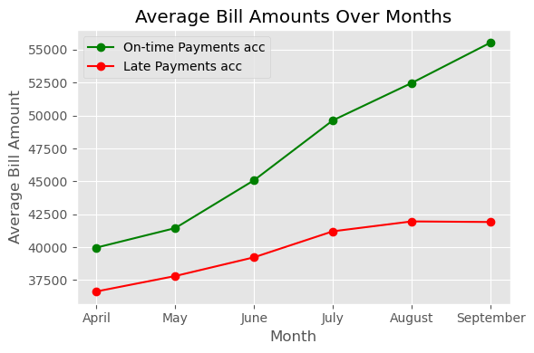
AVERAGE BILL AMOUNTS OVER MONTHS
The average bill amounts positively correlates with the number of late or on-time payments over the six months period.

Slide 17
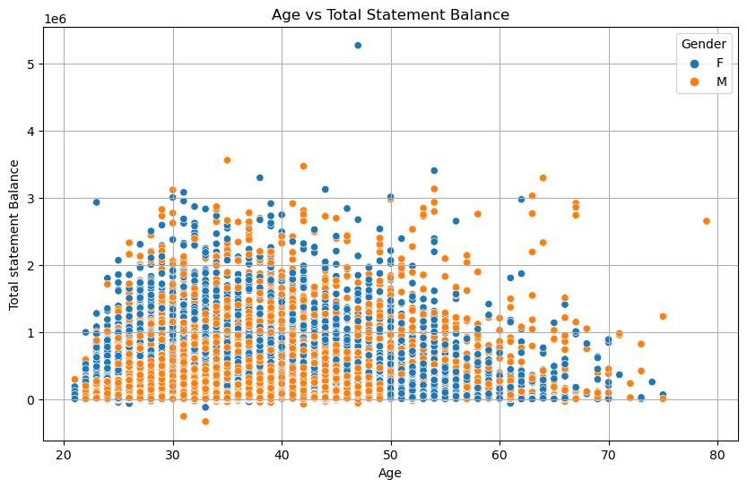
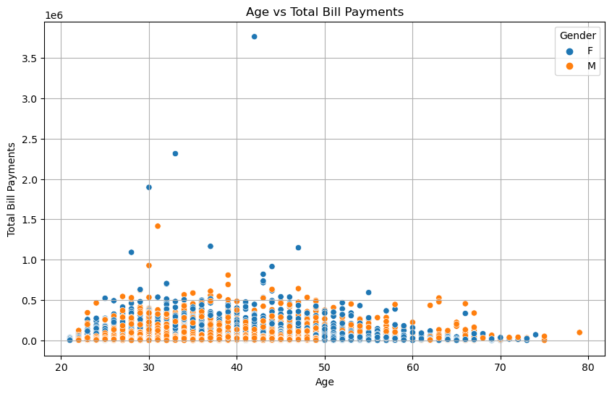
TOTAL STATEMENT BALANCE AND PAYMENT DISTRIBUTIONS ACROSS AGE GROUPS
Younger customers (under 40) tend to use credit more actively, with higher payments and more variable balances. As customers age, their payments and balances generally decrease, especially after 50, indicating more conservative spending.
There is no major difference in behavior between males and females in terms of payments or balances.

Slide 18
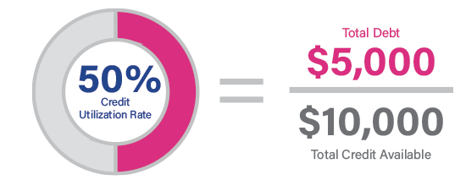
Credit Utilization Ratio
Credit Utilization Ratio or Credit Utilization Rate is the percentage of available credit that you are using on your credit cards and other lines of credit. It is based on the balances that appear in your credit report. In general, a lower utilization rate is best. CUR can be an important factor in determining the credit scores.
Calculation:
Find your balances and credit limits from your credit report.
Add up the revolving accounts' balances and credit limits.
Divide the total balance by the total credit limit and then multiply by 100.
Source: https://www.experian.com/blogs/ask-experian/credit-education/score-basics/credit-utilization-rate/

Slide 19
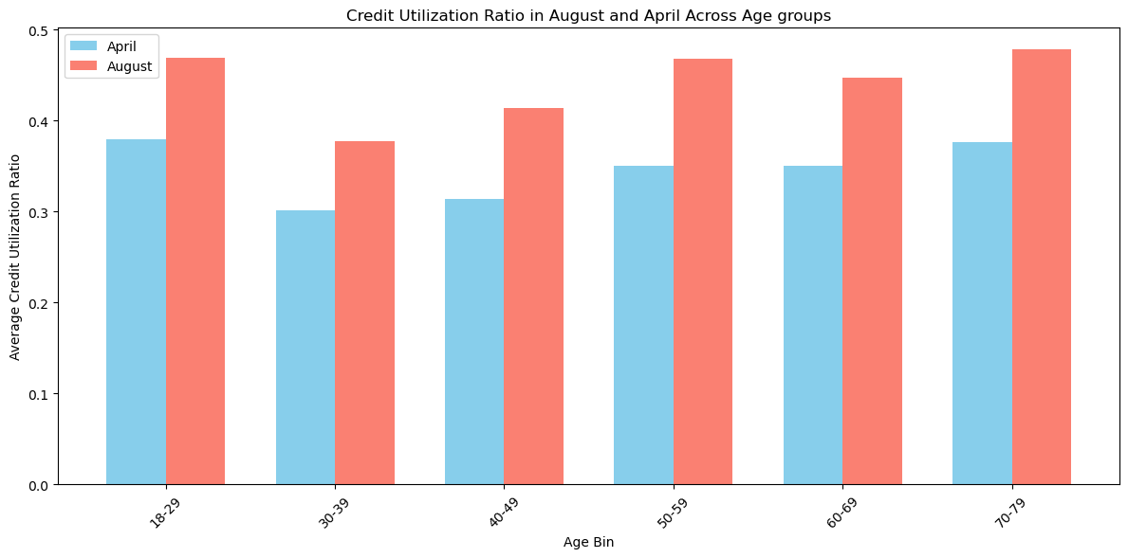
Average CUR Score by Age Group (April vs. August)
On average, credit utilization increased from April to August across all age groups

Slide 20
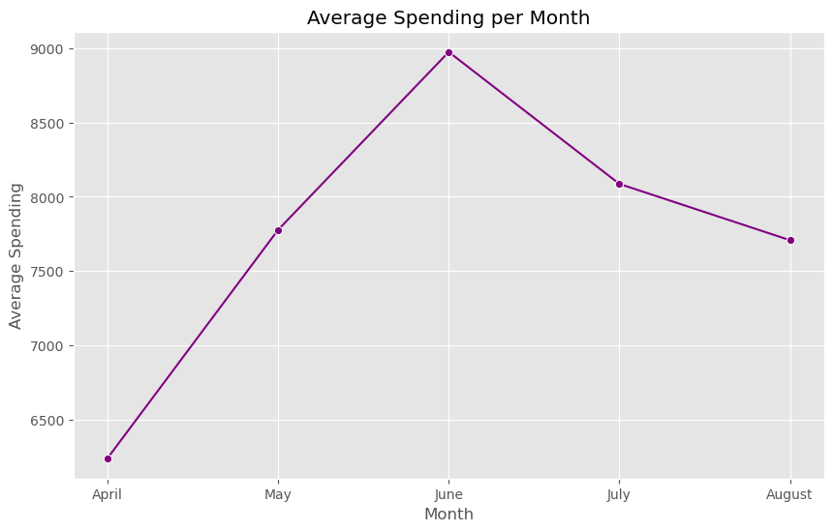
AVERAGE SPENDING PER MONTH
The trend chart below shows the seasonal spending of the credit card clients. Significant spending is observed in the month of June.
June

Slide 21
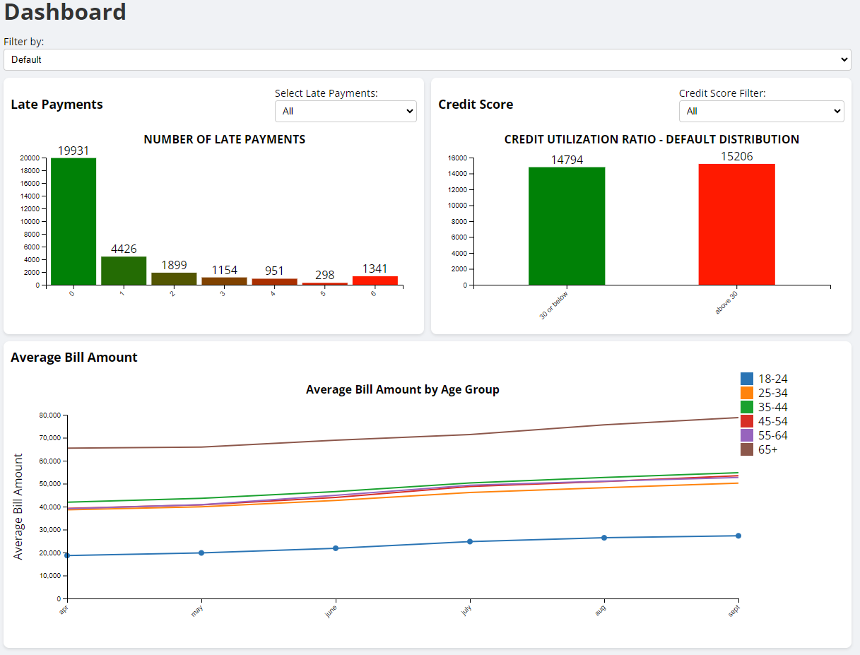
DASHBOARD
Our dashboard displays the following KPIs:
Late Payments
Filters:
Gender
Marital Status
Age Group
Education
Credit Score
Filters:
Above 30
30 or below
Average Bill Amount Trend

Slide 22

SUMMARY
IDENTIFY POTENTIAL DEFAULT OF CREDIT CARD CLIENTS
AGE (the old and the young)
Marriage (other has the highest potential default)
Education - the lowest education has the highest default
KEY DRIVERS FOR CHARGE-OFF RATES
Key Drivers for uncollectable debt (charge off)
66% of the accounts were not late for their payments
CREDIT SCORE & CREDIT UTILIZATION RATIO
Increases with all groups over time

Slide 23
Thank You
Group #1
Jimmy Kim
Ernawaty Ernawaty
Mounika Lingala
Judy Pin
Thet Win

